Slide 1
Practical Kinetics
Exercise 4:
Reaction Progress Analysis of a Catalytic Reaction
Objectives:
Same Excess
Different Excess
Extracting Rate Constants

Slide 2
Introduction
In this exercise, we will examine a concentration vs. time dataset for a hypothetical catalytic reaction (Michaelis–Menten):
What is the order in A and B?
What are the various rate constants?
In dataset3.csv, you will find 4 experimental runs: P1, P2, P3, P4. Each abbreviation represents the product concentration from its respective run.
Defining the excess (e) as [B]–[A]:
Run # | [A]₀ | [B]₀ | Excess
1 | 1.0 | 1.2 | +0.2
2 | 1.0 | 1.0 | +0.0
3 | 1.0 | 0.8 | –0.2
4 | 0.8 | 0.8 | +0.0

Slide 3
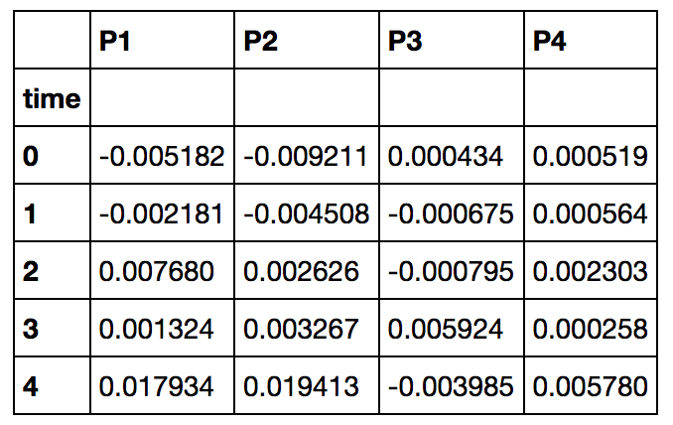
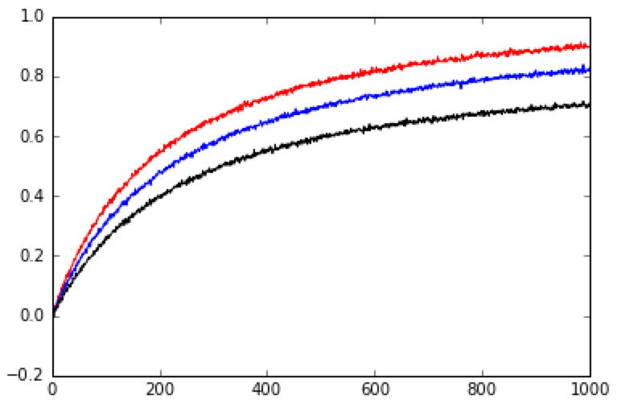
Step 1: Import Data
Use pandas to import the data:
df = pd.read_csv("dataset3.csv")
df.set_index("time",inplace=True)
time = df.index
df.head()
1000 seconds of data are present.
Plot the first three runs:
plt.plot(time, df.P1, "r")
plt.plot(time, df.P2, "b")
plt.plot(time, df.P3, "k")
plt.show()
Bigger excesses give faster
reactions, but the maximum
amount of product is always
1.0 M.
[P] vs. time
Run # | [A]₀ | Excess
1 | 1.0 | +0.2
2 | 1.0 | +0.0
3 | 1.0 | –0.2

Slide 4
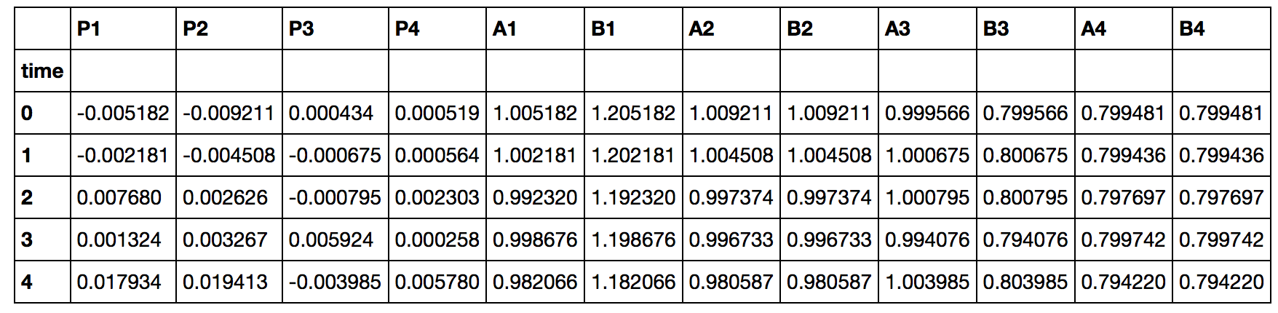
Step 2: Infer Starting Material Concentrations
Assuming there are no side reactions, we can infer [A] and [B] at all times from [P]. (Alternatively, we could try to measure those quantities directly.)
Make new DataFrame columns for A and B (A1, B1, A2, B2, etc.):
def estimate_SM(index, initial_A_concentration, excess):
P = df["P%d" % index]
A = initial_A_concentration - P
B = A + excess
df["A%d" % index] = Series(A, index = time)
df["B%d" % index] = Series(B, index = time)
estimate_SM(1, 1.0, 0.2)
estimate_SM(2, 1.0, 0.0)
estimate_SM(3, 1.0, -0.2)
estimate_SM(4, 0.8, 0.0)
df.head()

Slide 5
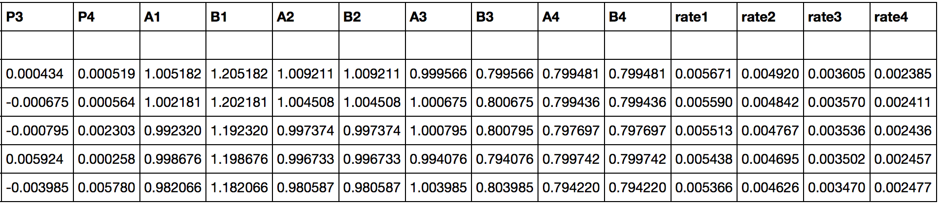
Step 3: Compute Rate
Now, use polynomial fitting to get at the rate. Put it in columns P1, P2, P3, P4:
polynomial_order = 15
def estimate_rate(index):
concentration = df["P%d" % index]
poly_coeff = np.polyfit(time, concentration, polynomial_order)
polynomial = np.poly1d(poly_coeff)
fitted_concentration = polynomial(time)
derivative = np.polyder(polynomial)
rate_vector = derivative(time)
df["rate%d" % (i+1)]=Series(rate_vector, index=time)
return rate_vector
for i in range(4):
rate_vector = estimate_rate(i+1)
df.head()

Slide 6
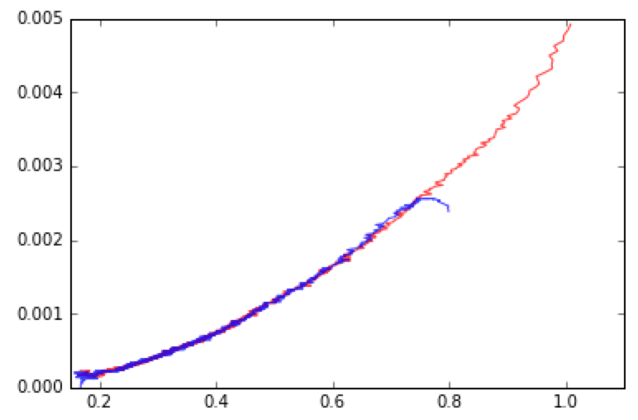
Step 4: Same Excess Analysis
Plot rate vs. concentration for runs 2 and 4, which have the same excess:
plt.plot(df.A2, df.rate2, "r", alpha=0.75)
plt.plot(df.A4, df.rate4, "b", alpha=0.75)
plt.xlim(0.15,1.1)
plt.ylim(0.0,0.005)
plt.show()
alpha sets the transparency of each line.
Again, despite some edge artifacts, the overlay is very good.
This indicates that there is no catalyst deactivation or product inhibition.
As to our earlier assumption about no side reactions: if there are any, they have the same stoichiometry as the catalytic reaction. We could verify this by measuring A and B independently and examining the mass balance in P.
rate vs. [A], excess = 0.0

Slide 7
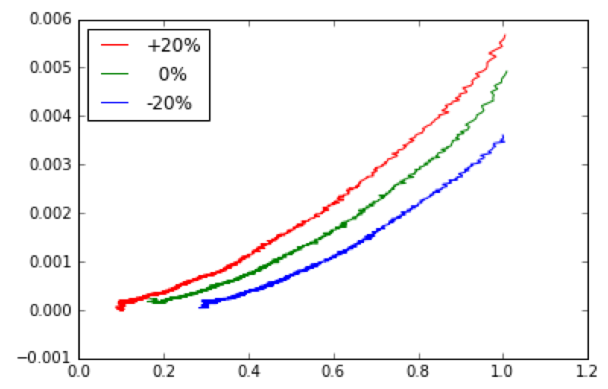
Step 5: Different Excess Analysis
Now, let’s plot the different excess data:
plt.plot(df.A1, df.rate1, "r", label="+20%")
plt.plot(df.A2, df.rate2, "g", label=" 0%")
plt.plot(df.A3, df.rate3, "b", label="-20%")
plt.legend(loc="best")
plt.show()
Larger excesses give bigger rates.
The 1+rate law is:
What happens if we plot rate/[B]
vs. [A]?
rate vs. [A]

Slide 8
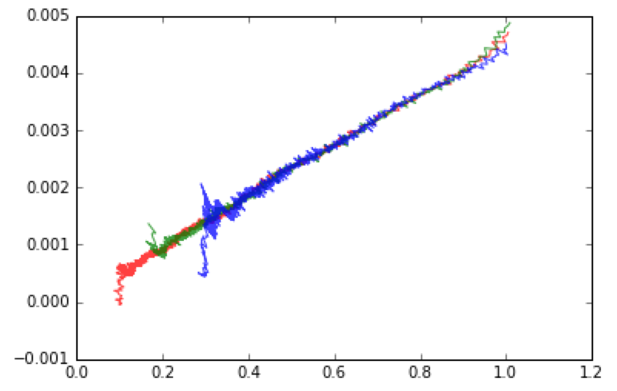
Step 6: Different Excess Analysis
Rate / [B] vs. [A]:
plt.plot(df.A1,df.rate1/df.B1,"r", alpha=0.75)
plt.plot(df.A2,df.rate2/df.B2,"g", alpha=0.75)
plt.plot(df.A3,df.rate3/df.B3,"b", alpha=0.75)
plt.show()
rate / [B] vs. [A]
If the resting state is free catalyst ( [cat] ≈ [cat]_{T} ), the denominator ≈ 1 and we get straight lines whose intercept depends on excess. The slope does not depend on excess, so everything overlays, consistent with the graph.

Slide 9
Step 6: Different Excess Analysis
Rate / [B] vs. [A]:
plt.plot(df.A1,df.rate1/df.B1,"r", alpha=0.75)
plt.plot(df.A2,df.rate2/df.B2,"g", alpha=0.75)
plt.plot(df.A3,df.rate3/df.B3,"b", alpha=0.75)
plt.show()
rate / [B] vs. [A]
If the resting state is bound catalyst ( [cat•A] ≈ [cat]_{T} ), the denominator ≈ K[A] and we would expect horizontal lines that overlay because the constant is not a function of excess. This is not observed here.

Slide 10
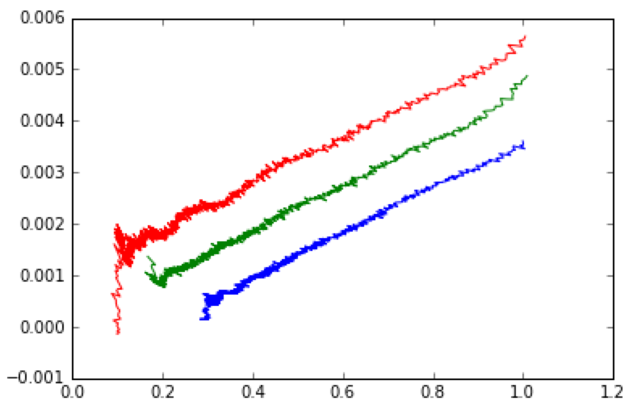
Step 5: Different Excess Analysis
Rate / [A] vs. [A]:
plt.plot(df.A1,df.rate1/df.A1,"r")
plt.plot(df.A2,df.rate2/df.A2,"g")
plt.plot(df.A3,df.rate3/df.A3,"b")
plt.show()
Recall that [B] – [A] = excess (e).
If free catalyst is dominant, the
denominator ≈ 1 and we get straight
lines whose intercept depends on excess.
This is what we observe:
rate / [A] vs. [A]

Slide 11
Step 5: Different Excess Analysis
Rate / [A] vs. [A]:
plt.plot(df.A1,df.rate1/df.A1,"r")
plt.plot(df.A2,df.rate2/df.A2,"g")
plt.plot(df.A3,df.rate3/df.A3,"b")
plt.show()
Recall that [B] – [A] = excess (e).
If bound catalyst is dominant, the
denominator ≈ K[A]. We would expect
saturation behavior in [A], with the
curvature depending on excess.
rate / [A] vs. [A]
This is not observed here.

Slide 12
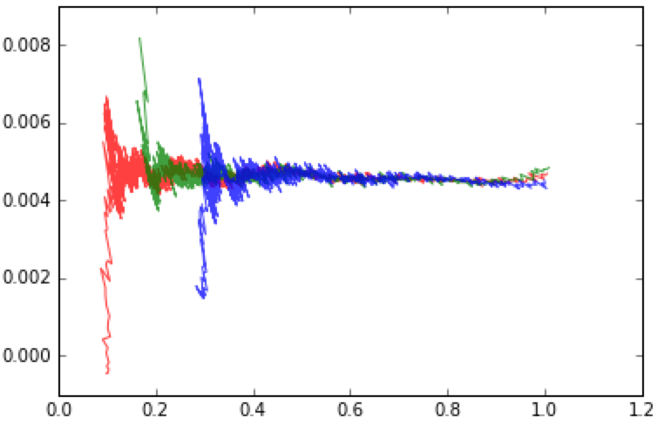
Step 5: Different Excess Analysis
Plot rate / [A][B] vs. [A]:
plt.plot(df.A1,df.rate1/df.A1/df.B1,"r", alpha=0.75)
plt.plot(df.A2,df.rate2/df.A2/df.B2,"g", alpha=0.75)
plt.plot(df.A3,df.rate3/df.A3/df.B3,"b", alpha=0.75)
plt.show()
Now we get horizontal, overlaying lines:
rate / [A][B] vs. [A]
When the resting state is free catalyst ( [cat] ≈ [cat]_{T} ), we expect this to be a constant that does not depend on excess.
This is what we observe here.
Overall, the reaction is essentially first order in [A] and [B].

Slide 13
Step 6: Three Parameter Fit
To extract the rate constants, we can fit to the steady state rate law:
total_catalyst = 0.05
def make_rate_law(excess):
def rate_law(A, k_1, k_minus1, k_2):
B = A + excess
numerator = k_1 * k_2 * A * B * total_catalyst
denominator = k_minus1 + k_2*B + k_1*A
return numerator / denominator
return rate_law
rate_law = make_rate_law(0.20)
popt,pcov = curve_fit(rate_law, df.A1, df.rate1)
errors = np.sqrt(np.diag(pcov))
print "k_1 = %.2f ± %.2f" % (popt[0], errors[0])
print "k_minus1 = %.2f ± %.2f" % (popt[1], errors[1])
print "k_2 = %.2f ± %.2f" % (popt[2], errors[2])
fitted_rate = rate_law(df.A1, popt[0], popt[1], popt[2])
plt.plot(df.A1,df.rate1,"b")
plt.plot(df.A1,fitted_rate,"r")
plt.show()
This is the same curve fitting strategy we used in previous exercises.
Technical Note: We nest two functions to prevent the excess from being treated as a parameter for optimization. This strategy is called creating a “closure” or “lambda.”

Slide 14
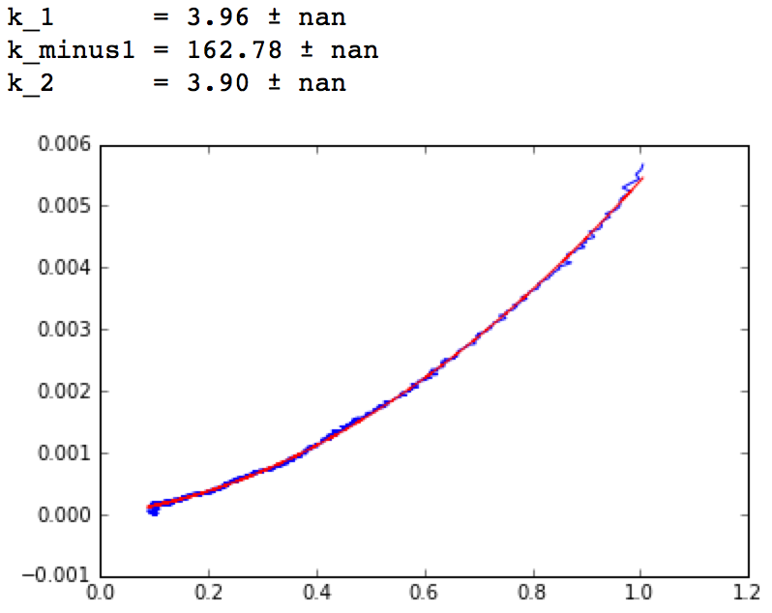
Step 6: Three Parameter Fit
The fit is very good, and the extracted parameters agree with the actual values of k₁ = 10, k₋₁ = 100, and k₂ = 1:
However, the error bars are “not a number”! This suggests that the data might be nearly two-dimensional, even though the fit is three-dimensional.
This is consistent with the fact that this is a pre-equilibrium scenario, but we are fitting to a steady state rate law. When the actual k₋₁ is so large, fitting adjustments in k₁ are indistinguishable from inverse adjustments in k₋₁.
rate vs. [A] (run 1)

Slide 15
Step 8: Fitting Each Dataset
Since we know the rate data are poor near the edges of each run, we can cut off five points from the beginning and end of each dataset and then fit:
cutoff = 5
def fit_constants(index, excess):
rate_law = make_rate_law(excess)
x = np.array(df["A%d" % index])[cutoff:-cutoff]
y = np.array(df["rate%d" % index])[cutoff:-cutoff]
popt,pcov = curve_fit(rate_law, x, y)
errors = np.sqrt(np.diag(pcov))
print "=== Run %d ===" % index
print "K = %.3f ± %.3f" % (popt[0], errors[0])
print "k_2 = %.3f ± %.3f" % (popt[1], errors[1])
fitted_rate = rate_law(x, popt[0], popt[1])
#plt.plot(x, y, "b")
#plt.plot(x, fitted_rate, "r")
#plt.show()
fit_constants(1, 0.2)
fit_constants(2, 0.0)
fit_constants(3, -0.2)
fit_constants(4, 0.0)
To view each fit, uncomment the plotting lines above by removing the # signs.

Slide 16
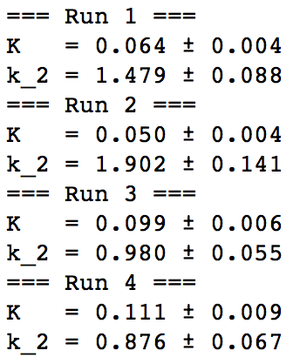
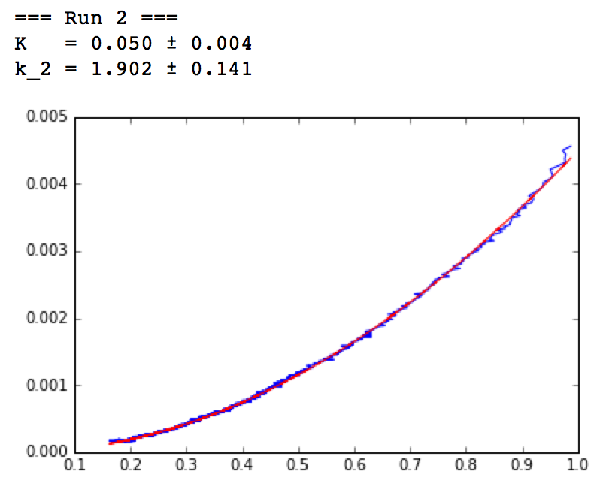
Step 7: Two Parameter Fit
The results are in good agreement with the actual parameters:
(To fit all of the data at once, we would need to use a different fitting package that supports multiple indepedent variables, since rate is a function of both concentration and excess.)
rate vs. [A] (run 1)

Slide 17
Summary
(1) Read a CSV:
import pandas as pd
df = pd.read_csv("dataset3.csv")
df.set_index("time",inplace=True)
time = df.index
df.head()
(2) Infer starting material concentrations from excess:
def estimate_SM(index, initial_A_concentration, excess):
P = df["P%d" % index]
A = initial_A_concentration - P
B = A + excess
df["A%d" % index] = Series(A, index = time)
df["B%d" % index] = Series(B, index = time)
estimate_SM(1, 1.0, 0.2)
estimate_SM(2, 1.0, 0.0)
estimate_SM(3, 1.0, -0.2)
estimate_SM(4, 0.8, 0.0)
df.head()

Slide 18
Summary
(3) Fit to a polynomial and take the derivative to get rate:
polynomial_order = 15
def estimate_rate(index):
concentration = df["P%d" % index]
poly_coeff = np.polyfit(time, concentration, polynomial_order)
polynomial = np.poly1d(poly_coeff)
fitted_concentration = polynomial(time)
derivative = np.polyder(polynomial)
rate_vector = derivative(time)
df["rate%d" % (i+1)]=Series(rate_vector, index=time)
return rate_vector
for i in range(4):
rate_vector = estimate_rate(i+1)
The order of the polynomial should be the smallest possible that gives consistent rates across all the experiments.
(4) Same/Different Excess Plots:
plt.plot(df.A2, df.rate2/df.B2, "r", alpha=0.75)
plt.plot(df.A4, df.rate4/df.B4, "b", alpha=0.75)
plt.xlim(0.15,1.1)
plt.ylim(0.0,0.005)
plt.show()

Slide 19
Summary
(5) Fit runs to a steady state rate law:
cutoff = 5
def fit_constants(index, excess):
rate_law = make_rate_law(excess)
x = np.array(df["A%d" % index])[cutoff:-cutoff]
y = np.array(df["rate%d" % index])[cutoff:-cutoff]
popt,pcov = curve_fit(rate_law, x, y)
errors = np.sqrt(np.diag(pcov))
print "=== Run %d ===" % index
print "K = %.3f ± %.3f" % (popt[0], errors[0])
print "k_2 = %.3f ± %.3f" % (popt[1], errors[1])
fitted_rate = rate_law(x, popt[0], popt[1])
#plt.plot(x, y, "b")
#plt.plot(x, fitted_rate, "r")
#plt.show()
fit_constants(1, 0.2)
fit_constants(2, 0.0)
fit_constants(3, -0.2)
fit_constants(4, 0.0)

